Slide 1
Adjoint-based sensitivity analysis of a reacting jet in crossflow 69th Annual Meeting of the APS Division of Fluid Dynamics, 20nd Nov 2016
Palash Sashittalª
Taraneh Sayadi^{a,b}
Peter Schmid^{c}
Ik Jang^{d}
Luca Magri^{d}
ª Department of Aerospace Engineering, University of Illinois at Urbana-Champaign, USA
^{b} Institute of Combustion, RWTH Aachen University, Germany
^{c} Department of Mathematics, Imperial College London, UK
^{d} Centre for Turbulence Research, Stanford University, USA

Slide 2
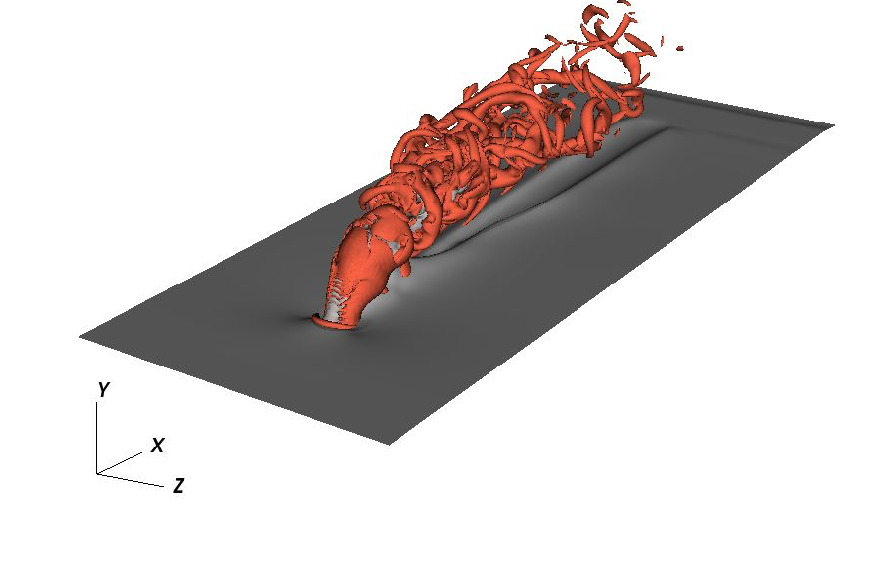
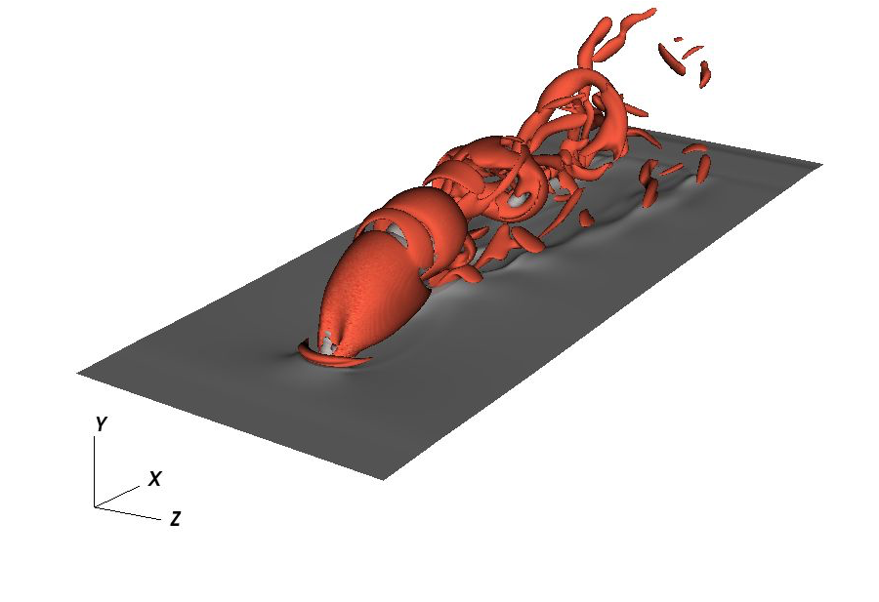
Motivation
Simulations of reactive flows rely on many models:
Chemical mechanism
Turbulent flow
Turbulent/Chemistry interaction
Model parameters are not known a priori
sensitivity analysis w.r.t. model parameters
Large number of parameters purely forward approach very expensive and infeasible
Objective:
Use adjoint-based technology to extract model parameter sensitivity analysis
Non-reacting
jet in crossflow
Reacting
jet in crossflow
The red iso-surfaces of Q criterion indicate vortical structures in instantaneous flow fields of reacting and non-reacting jets in crossflow
2

Slide 3
Configuration
Crossflow (air)
Laminar boundary layer over a flat plate
Jet (fuel)
Laminar circular jet in wall normal direction
Ma = 0.2
Re = 10,000
 | X | Y | Z
Size | 1.2 | 0.4 | 0.5
Grid | 480 | 256 | 200
BC | Inflow/outflow | Wall/outflow | Periodic
V_{jet}/V∞=3
Nozzle Diameter (D) = 0.05

Slide 4
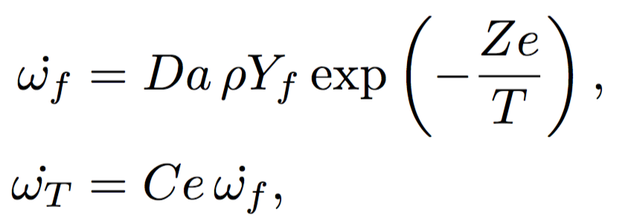
Numerical framework
Compressible NS equations, ideal gas, Ma = 0.2
Fourth-order finite differences in three spatial directions
Staggered variables, Curvilinear coordinates
Staggered variables are taken care of through local treatment
The geometric coefficients are simply multiplied
Time advancement scheme
NS equations : low storage RK3
Chemistry : fifth-order backward differentiation (DVODE)
Sponges are used at all the boundaries except the wall
NS equations
Chemistry
Da : Damkohler number
Ce : Heat release parameter
Ze : Zeldovich number
State variable (q) and combustion parameters (g) are

Slide 5
Mathematical formulation
State variables q
Combustion parameters g
Constraint
State equation
Cost function
Quantity of interest
Forming the Lagrange functional
Terminal rate of heat release
Integral heat release
Setting variation w.r.t. state variables to zero
Initializes the adjoint variables
Drives the adjoint equations
Variation w.r.t. combustion parameters gives the sensitivity

Slide 6
Adjoint framework
Two strategies:
Find the continuous adjoint and then discretize
Fine the discrete form of the inverse equations
Discrete adjoint approach of Fosas de Pando et al. (2012)
Flexible framework, same procedure independent of the complexity of the underlying non-linear equations
Matrices are not formally built
Nonlinear F(q,g)
q
dq/dt
dw/dt
L_{f}^{T} . w
dJ/dq
w
d(F(q,g))/dq = L_{f} . q
Local differentiation
Forward integration
Backward integration

Slide 7
Adjoint framework
Adjoint solution
The modular approach of Fosas de Pando et al. 2012 is employed to extract the discrete adjoint of the compressible reactive flow equations
(a)
(b)
Time evolution of direct and adjoint variables for (a) fuel mass fraction and (b) total energy fluctuations for period [0,T]. The dashed lines show the mean fuel mass fraction and total energy respectively. (red : +ve, blue : -ve)

Slide 8
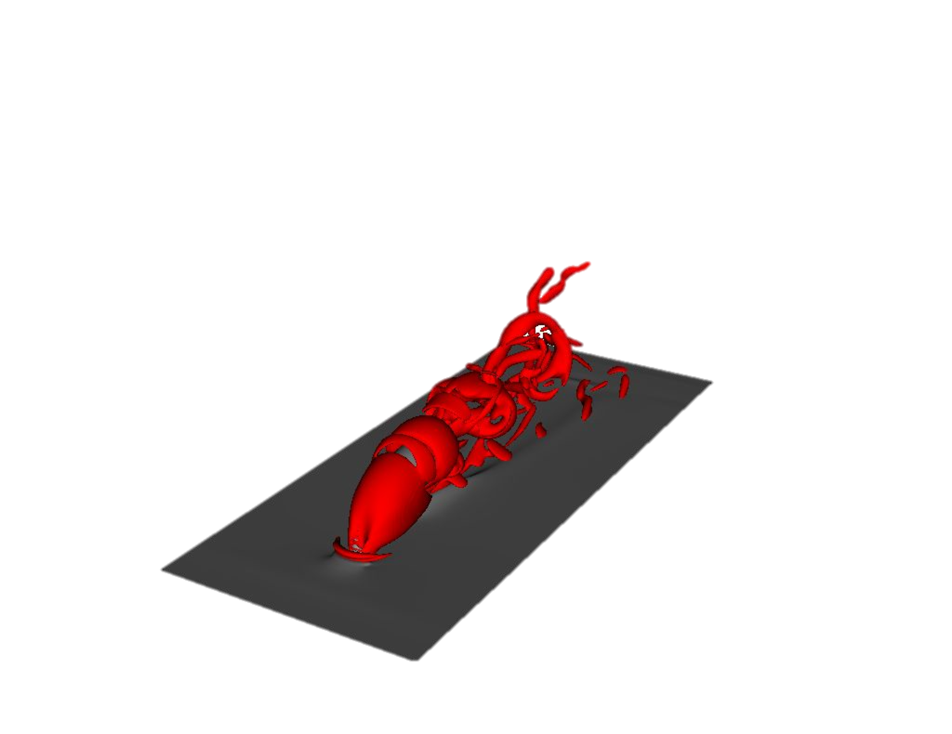
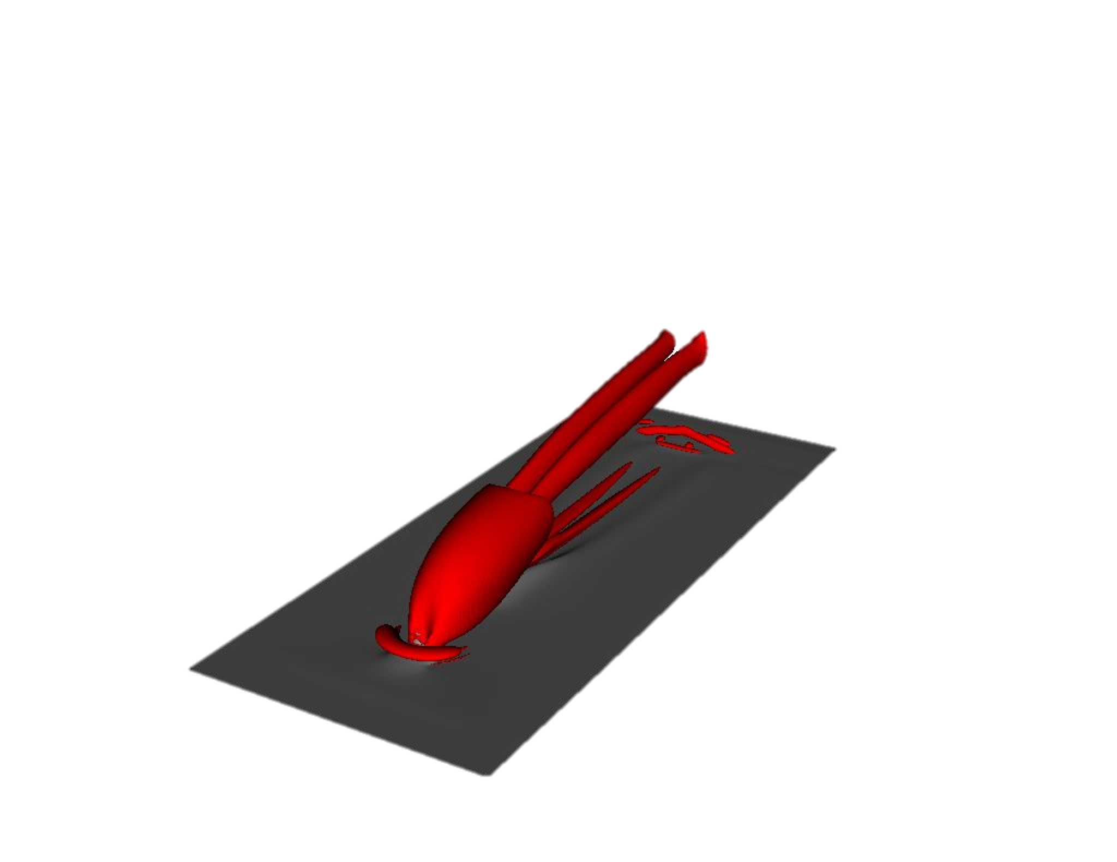
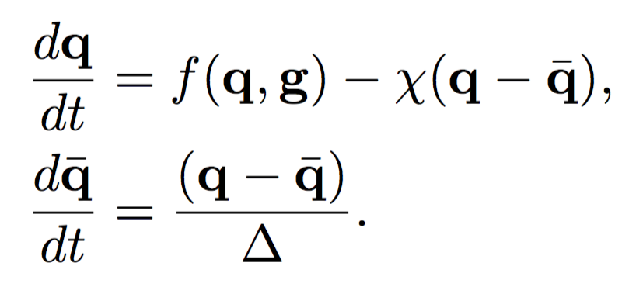
Base flow
Selective frequency damping (SFD) (Espen Åkervik et al. 2006) on the non-linear forward equations
This ensures that the base flow is a stationary solution of the nonlinear governing equations
The red iso-surfaces of Q criterion indicate vortical structures in instantaneous flow fields of reacting and non-reacting jets in crossflow

Slide 9
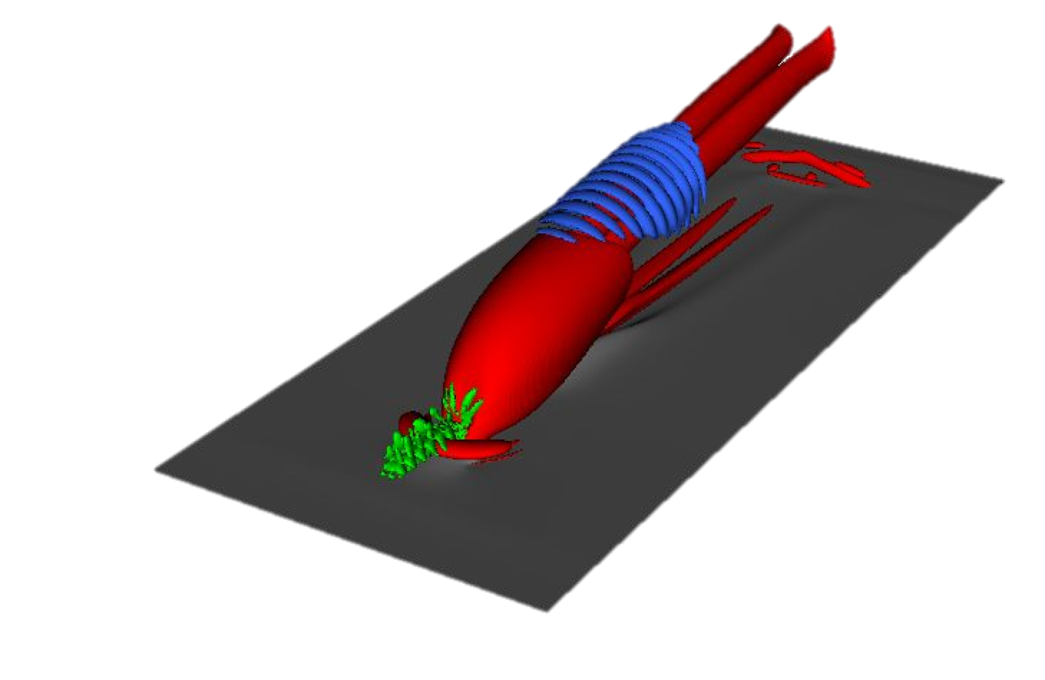
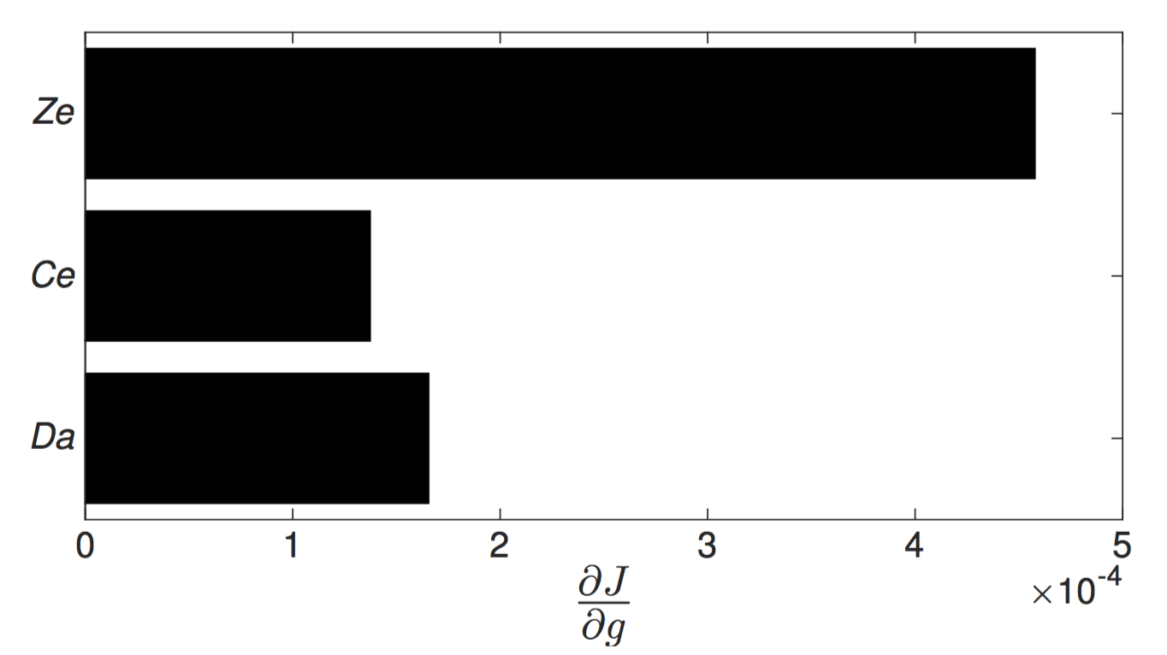
Results
Rate of heat release at terminal time T
Find the optimal initial condition (yielding maximum growth in energy)
Adjoint equations are used to find the gradient direction used in steepest descent to find the optimal solution
Find sensitivity of the rate of heat release w.r.t. combustion model parameters
Convergence of (a) the rate of heat release and (b) sensitivities with respect to the combustion model parameters
Q-criterion
Blue : final solution
Red : base flow
Green : Initial perturbation
Relative sensitivity of rate of heat release at time T with respect to the combustion model parameters

Slide 10
Results
Integral heat release
Find the sensitivity of integral heat release in period [0,T] w.r.t. combustion model parameters
Zeldovich number is most influential
The colors represent total energy E (increasing from blue to red) for an instantaneous reacting jet in crossflow flow field on the symmetry plane. The black line shows the contour for the reaction rate threshold used for the masking function.
Masking doesn’t change relative sensitivities
Relative sensitivity of the integral heat release for time period [0,T] with (a) the entire computational domain and (b) a masked domain with respect to the combustion parameters.

Slide 11
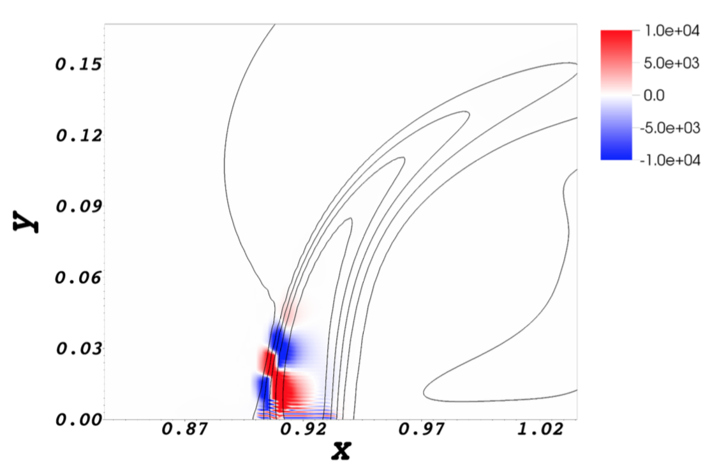
Results
Field sensitivities for combustion model parameters
Treat model parameters as functions in (x,y,z) space
Identify the most influential (sensitive) regions in the flow
Most influential region is located in the shear layer upstream of the jet, near the wall
Red and blue contours show positive and negative sensitivity of the integral heat release with respect to the Zeldovich number Ze. Black lines are wall-normal velocity contours of the base flow, representing the shear layer upstream and downstream of the jet inlet.

